Slide 1
Ecommerce Clients Machine Learning Project with Linear Regression
Prepared by Shakil Ahammed

Slide 2
Objective
In this project we work with a dataset which includes information about customers of an e-commerce website, including the following:
Avg. Session Length: Average session of in-store style advice sessions.
Time on App: Average time spent on App in minutes.
Time on Website: Average time spent on Website in minutes.
Length of Membership: How many years the customer has been a member.
In this project, we suppose that the company is trying to decide whether to focus their efforts on their mobile app experience or their website. We are here to help them make a data-driven decision.

Slide 3

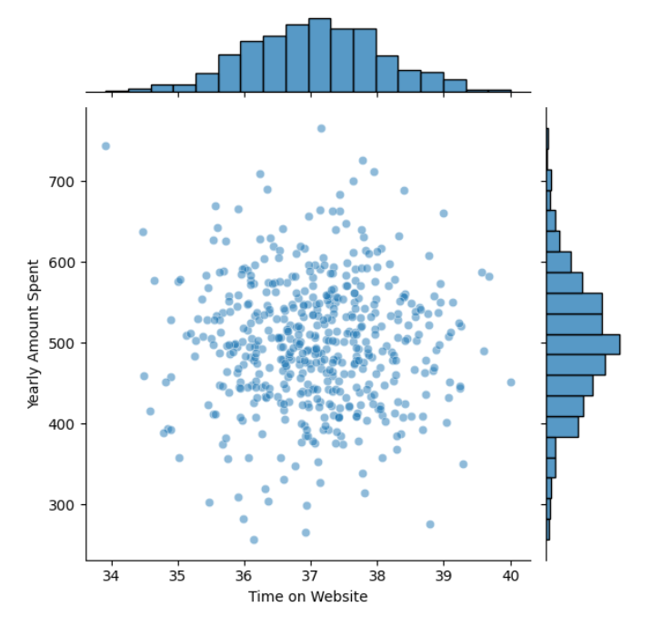
Insights
Time on website vs yearly amount spent

Slide 4
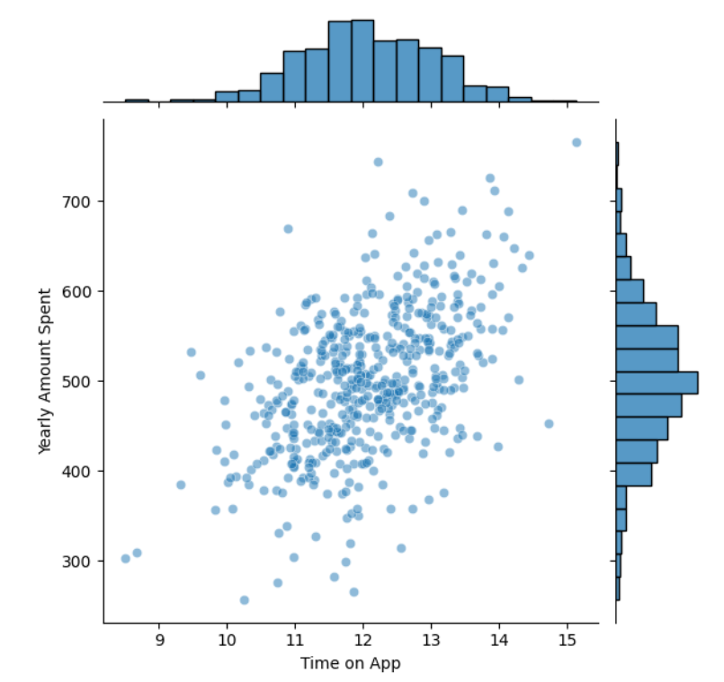
Time on app vs yearly amount spent

Slide 5
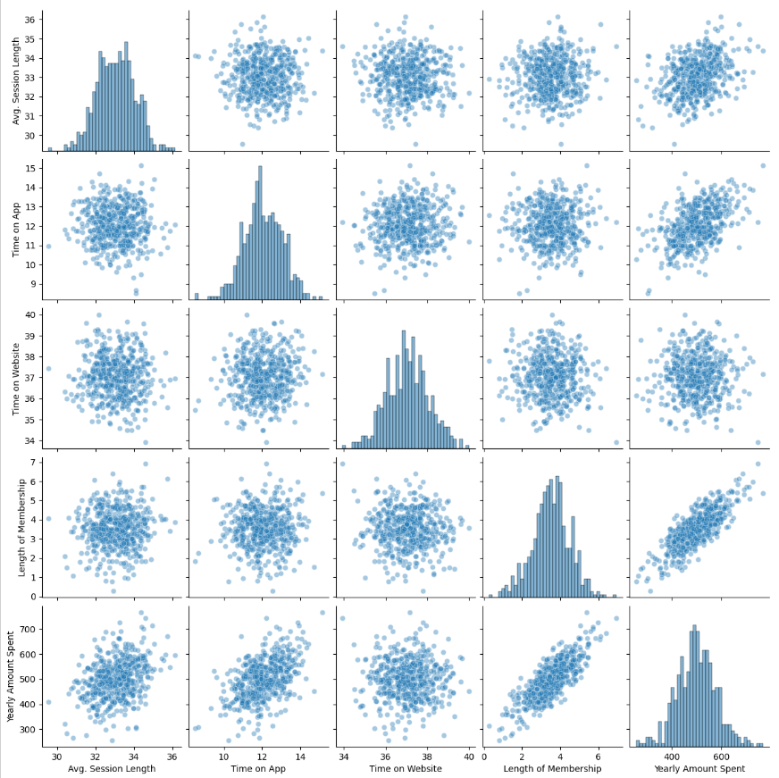
Correlation between all column

Slide 6
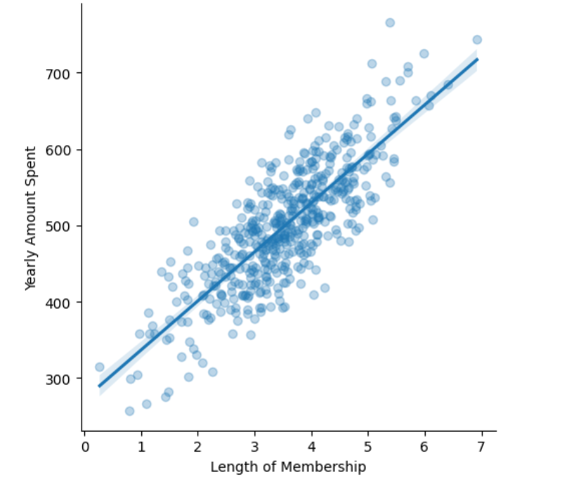
Length of membership vs yearly amount spent

Slide 7
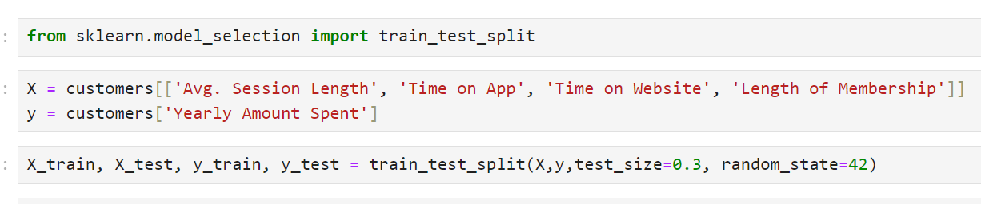
Splitting the data
X are the predictors, and y is the output. What we want to do is create a model that will take in the values in the X variable and predict y with a linear regression algorithm. We will use the SciKit-Learn library to create the model.

Slide 8
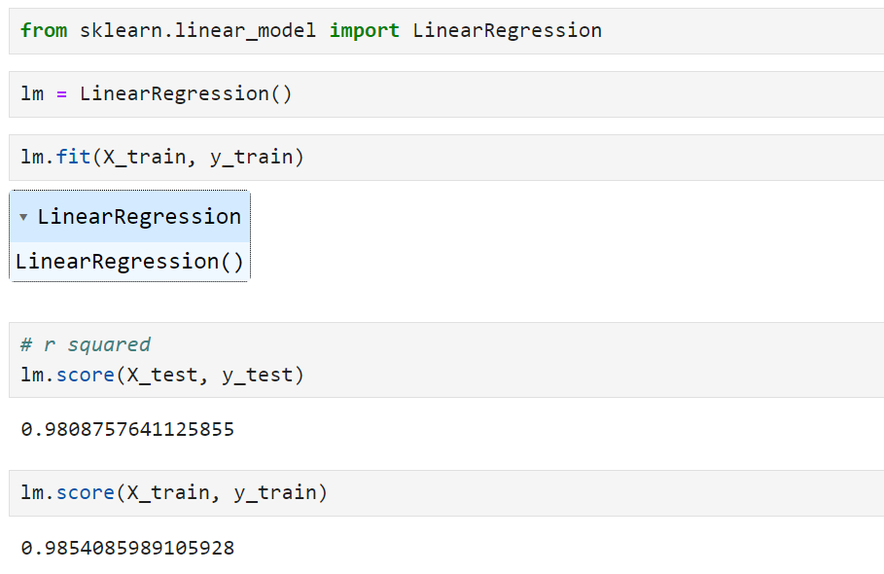
we create the model and feed the training data to it. This model will tell us which input has the biggest impact in the output (yearly expenditure). As the plots suggested, we find that the most important coefficient is that of the "Length of Membership" predictor, followed by the 'Time on App' and the 'Avg. Session Length'. The time on website does not seem to be an important factor to the amount a customer spends per year.

Slide 9
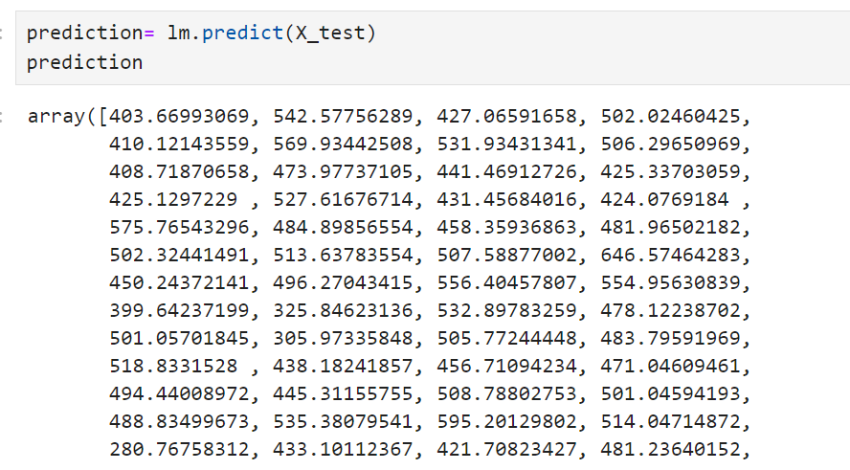
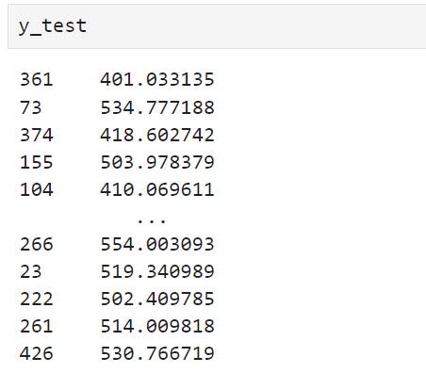
Now that the model is trained, we should be able to use it to make our predictions and evaluate our model. The scatter plot below plots the actual y values to the model's predictions. The model seems to behave accurately almost 98%.

Slide 10
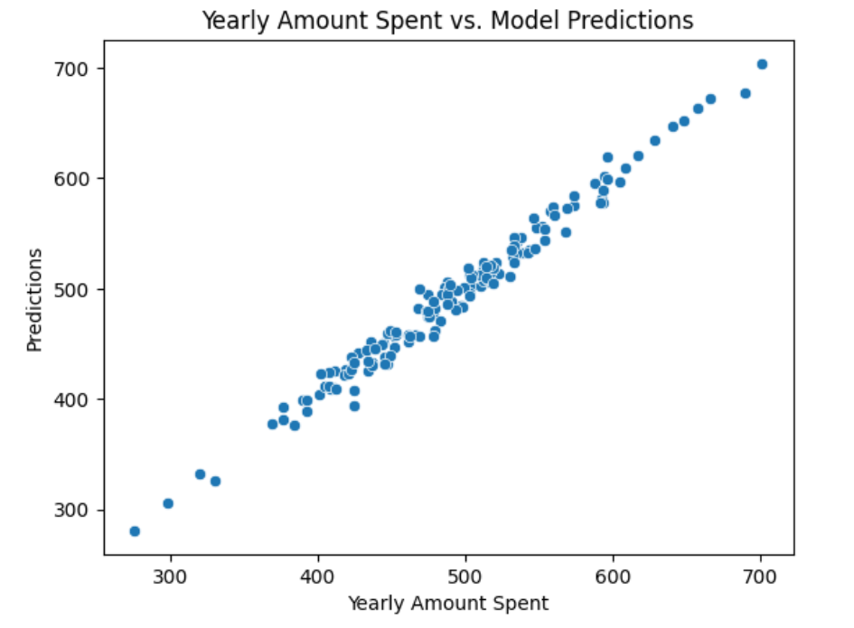
Scatter plot of actual values of y vs predicted values.

Slide 11
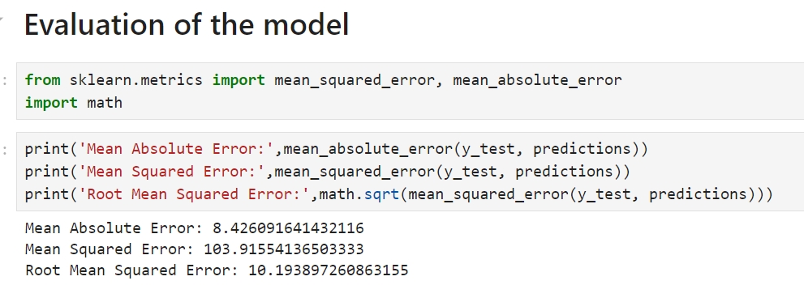

Slide 12
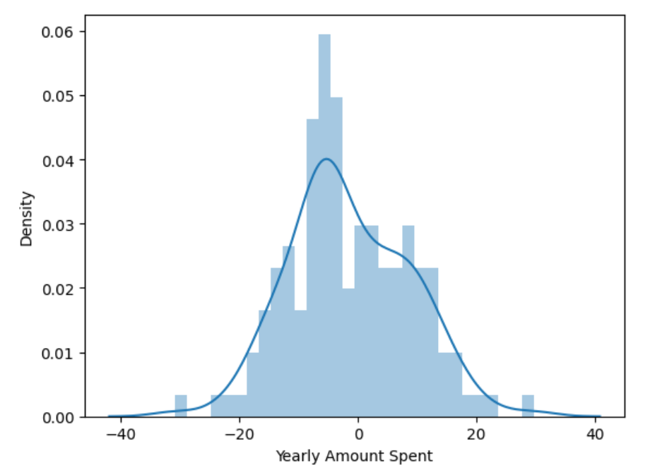
Distribution plot of the residuals of the model's predictions. They should be normally distributed.

Slide 13
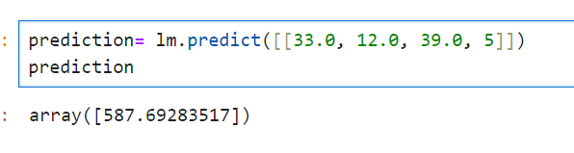
If we input
Avg. Session Length= 33 min, Time on App= 12 min, Time on Website= 39 min, Length of Membership= 5.
Our prediction Output(Yearly Amount Spent) is= 587.69 minutes.

Slide 14
Conclusion
It can be tricky to interpret the information in this analysis. According to the model, the most significant factor for clients is not the time spent on the app or website, but their length of membership. However, of the two predictors (desktop vs app), the app has the strongest influence by far. In fact, the time spent on the desktop website does not seem to have any correlation at all! In other words, according to the data, the amount of time that the customer spends on the desktop website has almost nothing to do with the amount of money they will spend.

Slide 15
Suggestions
We could interpret this in two different ways. Firstly, this could mean that the desktop website needs more work to make its visitors buy more. Secondly, it could mean that people tend to be more influenced by mobile applications of online stores than by desktop websites. So maybe efforts should be directed towards taking advantage of this fact. Indeed, the interpretation of this information requires expertise in the online marketing sphere. Our analysis and our model, however, does a very good job in weighting the predictors importance.

